Slide 1
PROJECT DONE BY: NAME : V.NAVEEN ROLL NO :2022BEC0056 TOPIC NAME : FIRE ALARAM USING ARDUINO FACULTY GUIDE :DR. SANTHOS KUMAR

Slide 2
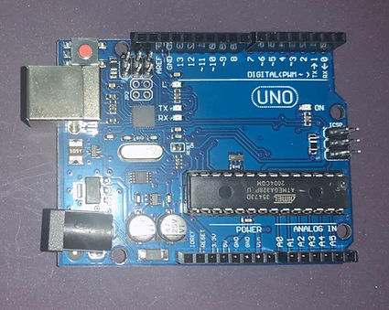
Hardware Requirements.
Arduino UNO Board.
Arduino board is a microcontroller that is used to accept inputs from sensors connected and provide an output action on the desired device connected to it. The sensor inputs can be from light-detecting sensors, motion sensors (Ultrasonic or IR), temperature sensors, etc. The output from this device can be received through other output devices such as LED, Buzzer, Serial monitor, etc.

Slide 3
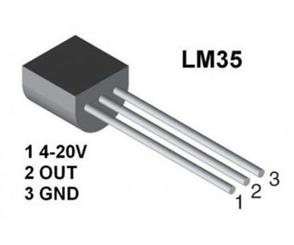
2. LM-35 Temperature Sensor
LM-35 #Temperature Sensor gives an analog output based on the instantaneous temperature value. This analog output is proportional to the instantaneous input.

Slide 4
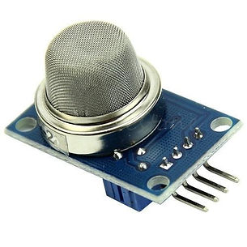
Gas sensor
The gas #sensor is used to measure the concentration or presence of gas in the atmosphere. It is also used to detect smoke in the air. Based on the gas, a potential difference is generated by changing the resistance of the material present inside the sensor. The output is measure in terms of Voltage.

Slide 5
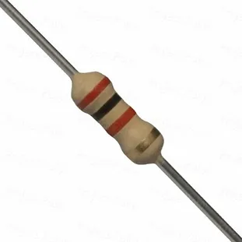
4. Resistors
Resistors are passive devices that restrict the flow of current or divide the voltage through the circuit. The input power passes through these resistors and then to the sensors to avoid damage.

Slide 6
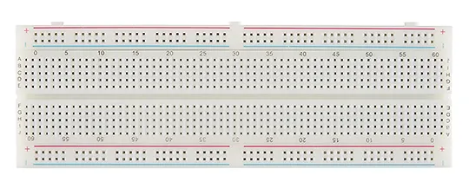
5. Breadboard
The breadboard is the basic component of any circuit building process. All components, be it input sensors or output display devices are connected to the power supply, microcontroller using wired connections through a breadboard. The holes in the breadboard are in series. There are various sizes like full-sized, half-sized, and mini breadboard.

Slide 7
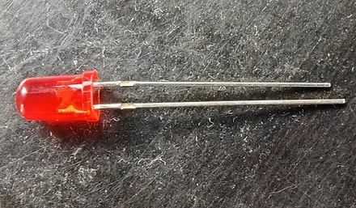
6. LED
Light Emitting Diode is a commonly used light source. It is a semiconductor that emits light when current flows through it.

Slide 8
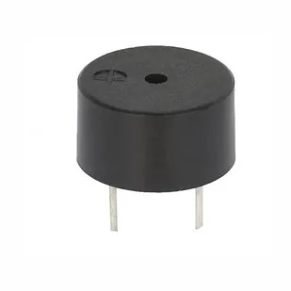
7. Piezo Buzzer
It is an electrical component that generates a beep sound on receiving an input. It works on the principle of #piezo crystal.

Slide 9
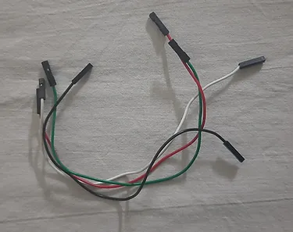
8. Jumper Wires
These are the main components that are used to establish the connections between different devices of the circuit.

Slide 10
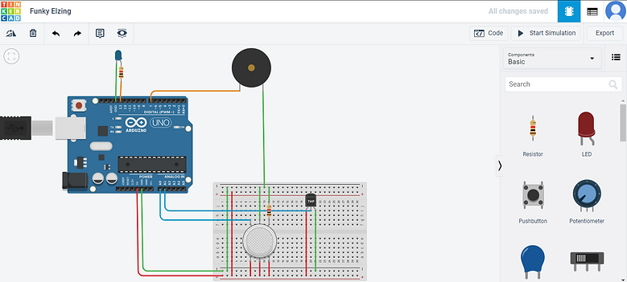
Circuit Connections

Slide 11
The circuit connections are as follows.
Firstly, we need to connect one line of the breadboard to the ground and the other to the power supply. This is done by connecting the 5V pin of the Arduino Board to one line of connection pins on the breadboard. The other line of the breadboard is connected to the ground terminal of the Arduino Board. These lines will be connected to other devices.
The Temperature sensor has three pins. Ground, Vout, and Vs (Supply). The Vs pin that has a range of 4-20V is connected to the power supply line of the breadboard. The Ground terminal of the sensor is connected to the ground line of the breadboard. The Vout terminal of the temperature sensor is connected to one of the Analog pins of the Arduino Board, A1.
Now let us learn how the connections are done with the Gas sensor. This sensor has 6 pins. 3 pins of the gas sensor are directly connected to the power supply line of the breadboard. Amongst the other 3 pins of the sensor, one pin is connected to one of the Analog pins of the Arduino Board, A0. The pin in the middle is connected to the ground line of the breadboard. The third pin of the sensor is connected to a resistor and then connected to the ground line.

Slide 12
The piezo buzzer is externally connected to the circuit. The ground pin of the #buzzer is connected to the ground line of the breadboard. Another pin of the buzzer is connected to the digital pin, PIN 7 of the Arduino Board.
Lastly, the LED is connected to the Arduino directly. The cathode of the LED is connected to the GND pin of Arduino and the anode of the LED is connected through a resistor to the digital pin 13 of the Arduino.

Slide 13
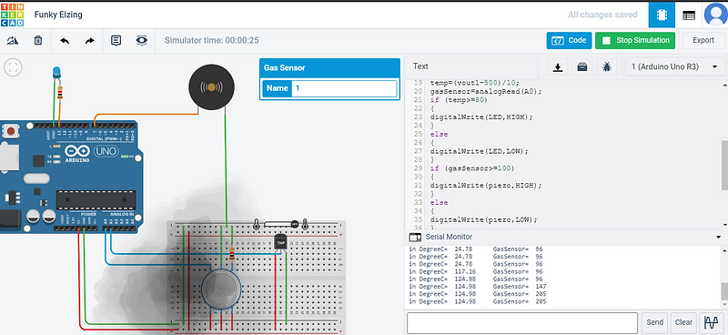
Working

Slide 14
Let us first learn how to work on TinkerCad #simulation software. Once on the TinkerCad page, select circuits, and search for the components required. The components are to be dragged and brought to the circuiting screen. The connection needs to be made by selecting the jumper wires. Corresponding colors for the wires can be selected.
Coming to the working of the circuit, we can understand it in two parts.
Part 1: Temperature sensor and its output.
The Temperature sensor takes in input and when the temperature increases, the voltage increases, and hence the output initiates the functioning of the Buzzer. For every one degree increase in temperature, there is a 10mV increase in the voltage.

Slide 15
Part2: Gas sensor and its output.
A gas sensor is also used to detect smoke along with the concentration of gases. Based on the type of gas present in the atmosphere, a potential difference is developed by changing the Resistance of the material present inside the sensor and the same is measured as output.
The Concentration of the gas is measured in ppm and the output analog value is needed to be converted into digital which is done by the #ADC (Analog to Digital Converter) present in the sensor itself. Based on the condition given in the code, the LED glows or remains OFF.
Watch the below-given project video for the practical explanation of designing the circuit and to know how the simulation #software works.

Slide 16
float temp;
float vout;
float vout1;
int LED = 13;
int gasSensor;
int piezo = 7;void setup(){
pinMode(A0,INPUT);
pinMode(A1,INPUT);
pinMode(LED,OUTPUT);
pinMode(piezo,OUTPUT);
Serial.begin(9600);}
void loop(){ vout=analogRead(A1); vout1=(vout/1023)*5000; temp=(vout1-500)/10; gasSensor=analogRead(A0); if(temp>=80) { digitalWrite(LED,HIGH); } else { digitalWrite(LED,LOW); } if(gasSensor>=100) { digitalWrite(piezo,LOW); } Serial.print("in DegreeC= "); Serial.print(" "); Serial.print(temp); Serial.print("\t"); Serial.print("GasSensor= "); Serial.print1n(); delay(1000);}

